Slide 1
Continuous Integration
David M. Rogers Oak Ridge National Laboratory
Software Productivity Track, ATPESC 2021
Contributors: David E. Bernholdt (ORNL), Mark C. Miller (LLNL), David M. Rogers (ORNL), James M. Willenbring (SNL)
Notes:
Designed to be 15 Minute Talk + 20 minutes for the live Travis CI demo

Slide 2
License, Citation and Acknowledgements
License and Citation
This work is licensed under a Creative Commons Attribution 4.0 International License (CC BY 4.0).
The requested citation the overall tutorial is: David E. Bernholdt, Anshu Dubey, Patricia A. Grubel, Rinku K. Gupta, and David M. Rogers, Better Scientific Software tutorial, in ISC High Performance, online, 2021. DOI: 10.6084/m9.figshare.14642520
Individual modules may be cited as Speaker, Module Title, in Better Scientific Software tutorial…
Acknowledgements
This work was supported by the U.S. Department of Energy Office of Science, Office of Advanced Scientific Computing Research (ASCR), and by the Exascale Computing Project (17-SC-20-SC), a collaborative effort of the U.S. Department of Energy Office of Science and the National Nuclear Security Administration.
This work was performed in part at the Argonne National Laboratory, which is managed by UChicago Argonne, LLC for the U.S. Department of Energy under Contract No. DE-AC02-06CH11357.
This work was performed in part at the Oak Ridge National Laboratory, which is managed by UT-Battelle, LLC for the U.S. Department of Energy under Contract No. DE-AC05-00OR22725.
This work was performed in part at the Lawrence Livermore National Laboratory, which is managed by Lawrence Livermore National Security, LLC for the U.S. Department of Energy under Contract No. DE-AC52-07NA27344.
This work was performed in part at the Los Alamos National Laboratory, which is managed by Triad National Security, LLC for the U.S. Department of Energy under Contract No.89233218CNA000001
This work was performed in part at Sandia National Laboratories. Sandia National Laboratories is a multi-mission laboratory managed and operated by National Technology and Engineering Solutions of Sandia, LLC., a wholly owned subsidiary of Honeywell International, Inc., for the U.S. Department of Energy’s National Nuclear Security Administration under contract DE-NA0003525.

Slide 3
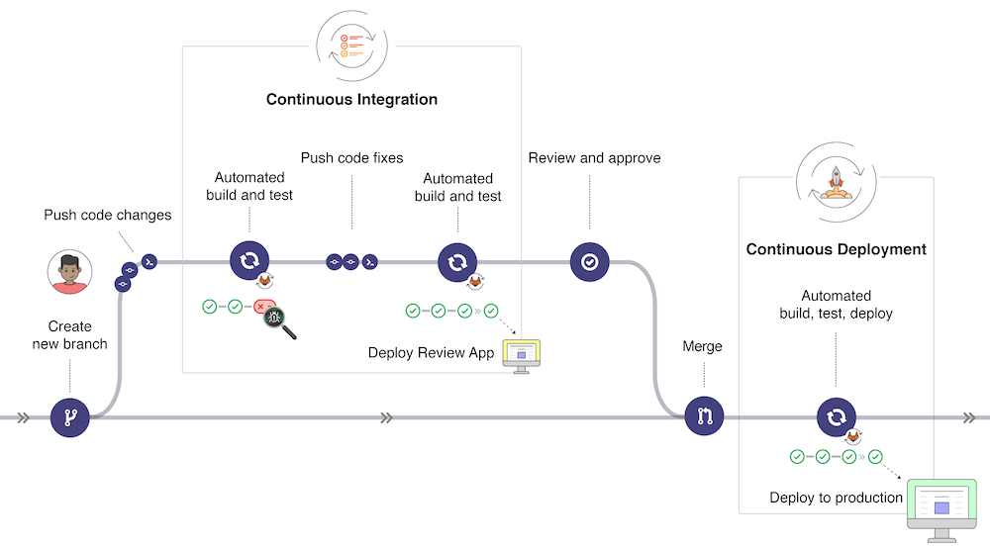
What is Continuous Integration (CI)
https://docs.gitlab.com/ee/ci/introduction/

Slide 4
What is Continuous Integration (CI) Testing
Testing
Focused, critical functionality (infrastructure), fast, independent, orthogonal, complete, …
Existing test suites often require re-design/refactoring for CI
Integration
Changes across key branches merged & tested to ensure the “whole” still works
Integration can take place at multiple levels
Individual project
Spack
E4S
Develop, develop, develop, merge, merge, merge, test, test, test…NO!
Develop, merge, test, develop, merge, test, develop, merge, test…YES!
Continuous
Changes tested every commit and/or pull-request (like auto-correct)
CI generally implies a lot of automation

Slide 5
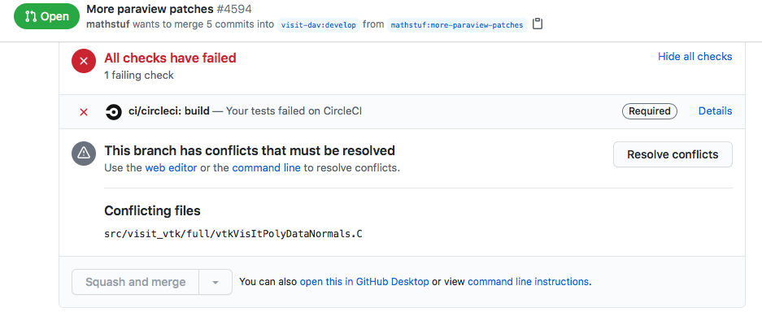
Automated Testing vs. Continuous Integration (CI) Testing
Automated Testing: Software that automatically performs tests and reliably detects and reports anomalous behaviors/outcomes.
Examples: Auto-test, CTest/CDash, nightly testing, `make check’
May live “next to” your development workflow
Potential issues: change attribution, timeliness of results, multiple branches of development
Continuous Integration (CI): automated testing performed at high frequency and fine granularity aimed at preventing code changes from breaking key branches of development (e.g. main)
Example: Disabled/enabled “Merge Pull Request” button on GitHub
Can also be run post merge
Lives “within” your development workflow
Potential issues: extreme automation, test granularity, coverage, 3rd-party services/resources

Slide 6
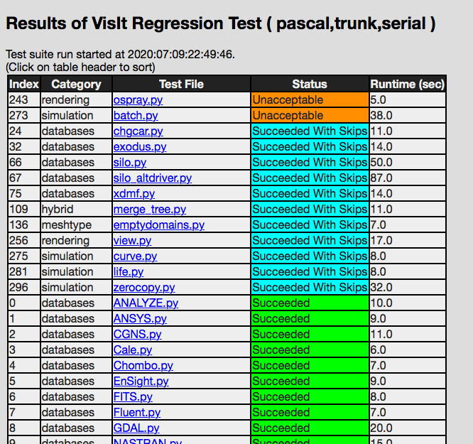
Examples…
Automated Nightly Testing Dashboard Lives “next to” your development work
CI Testing Lives embedded in your development work

Slide 7
What can make CI Difficult
Common situations
Advanced situations
Just getting started
Many technologies/choices; often in the ”cloud”
Solution: start small, simple, build up
Developing suitable tests
Many project’s existing tests not suitable for CI
CI testing is a balance of thoroughness and responsiveness
Solution: Simplify/refactor and/or sub-setting test suite
Ensuring sufficient coverage
Some changes to code never get tested – CI can provide a false sense of security
Solution: tools to measure it, enforce always increasing
Defining failure for many configurations / inconsistent failures
Bit-for-bit (exact) match vs. fuzzy match
Solution: absolute/relative tolerances → AI/ML
Numerous 3rd party libraries (TPLs)
Compiling takes too long
Solution: cache pre-built TPLs, containers
Performance testing
Avoid time-, space-, scaling-performance degradation
Solution: Perf. instrumentation and scheduled testing

Slide 8
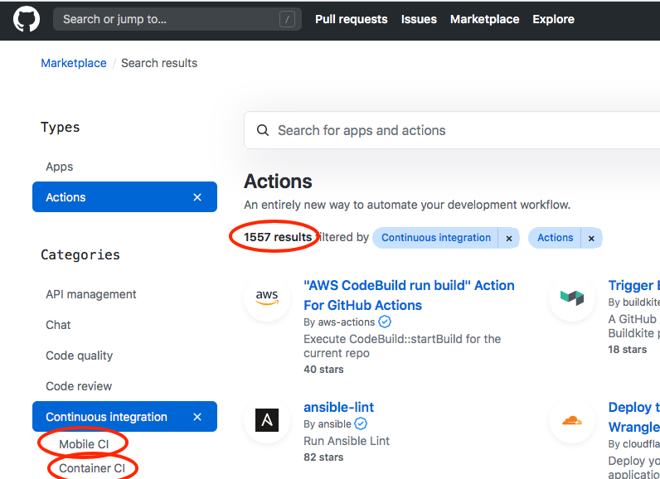
CI Resources (Where do jobs run?)
Free Cloud Resources (many free on GitHub, BitBucket, GitLab, etc.)
Travis-CI, Circle-CI, AppVeyor, Azure Pipelines,…
All launch a VM (Linux variants, Windows and OSX)
Constrained in time/size, hardware (e.g. GPU type/count)
Not a complete solution for many HPC/scientific codes, but a useful starting point.
Site-local Resources
Group, department, institution, computing facility
Examples: Bamboo @ LLNL, Jenkins @ ANL, Travis+CDash @ NERSC, etc.
ECP Program: GitLab-CI @ ANL, LANL, LLNL, NERSC, ORNL, SNL
Create your own by setting up resources/services

Slide 9






Examples…
codecov.io
travis-ci.com
github.com
Your code repository
Your CI Resources
LLNL
NERSC
bitbucket.llnl.gov
gitlab.nersc.gov
You

Slide 10
Getting started with CI
What configuration is most important?
Examples: gcc, icc, xlc? MPI-2 or MPI-3? Python 2, 3 or 2 & 3?
What functionality is most important?
Examples: vanilla numerical kernels? OpenMP kernels? GPU kernels? All of these?
Good candidates…
A “hello world” example for your project
At a minimum, even just building the code can be a place to start!
Once you’ve got the basics working, its easy to build up from there

Slide 11
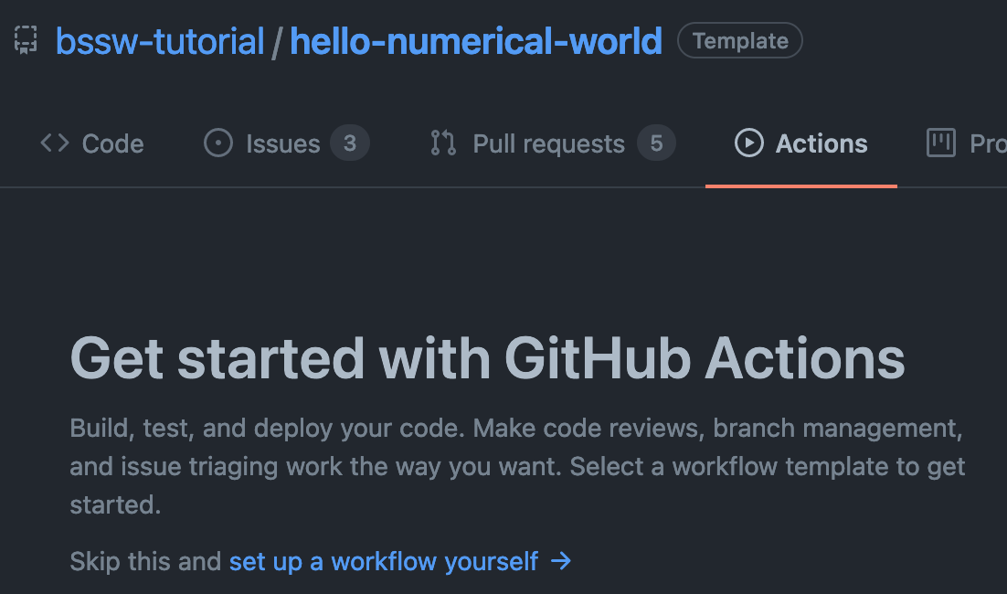
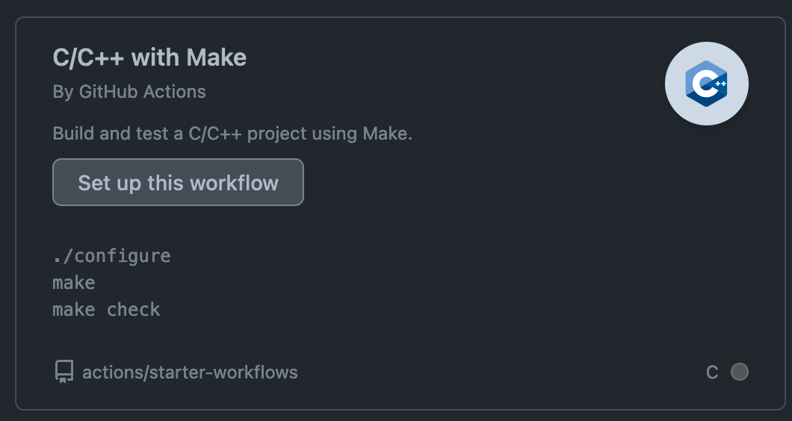
Getting started with CI:
Setting up CI
Service | Interface
Travis | repo YAML file [& repo scripts] | /.travis.yml in root of repo
GitLab | Web page configurator + repo YAML file [& repo scripts] | /.gitlab-ci.yml in root of repo
Bamboo | Web page configurator + repo scripts
GitHub Actions . . | Repo YAML file | .github/workflows/<test_name>.yml
Notes:
Update example to use GitLab? Should we even have this part? Stress getting things generally in order so they are adaptable to ECP CI.

Slide 12
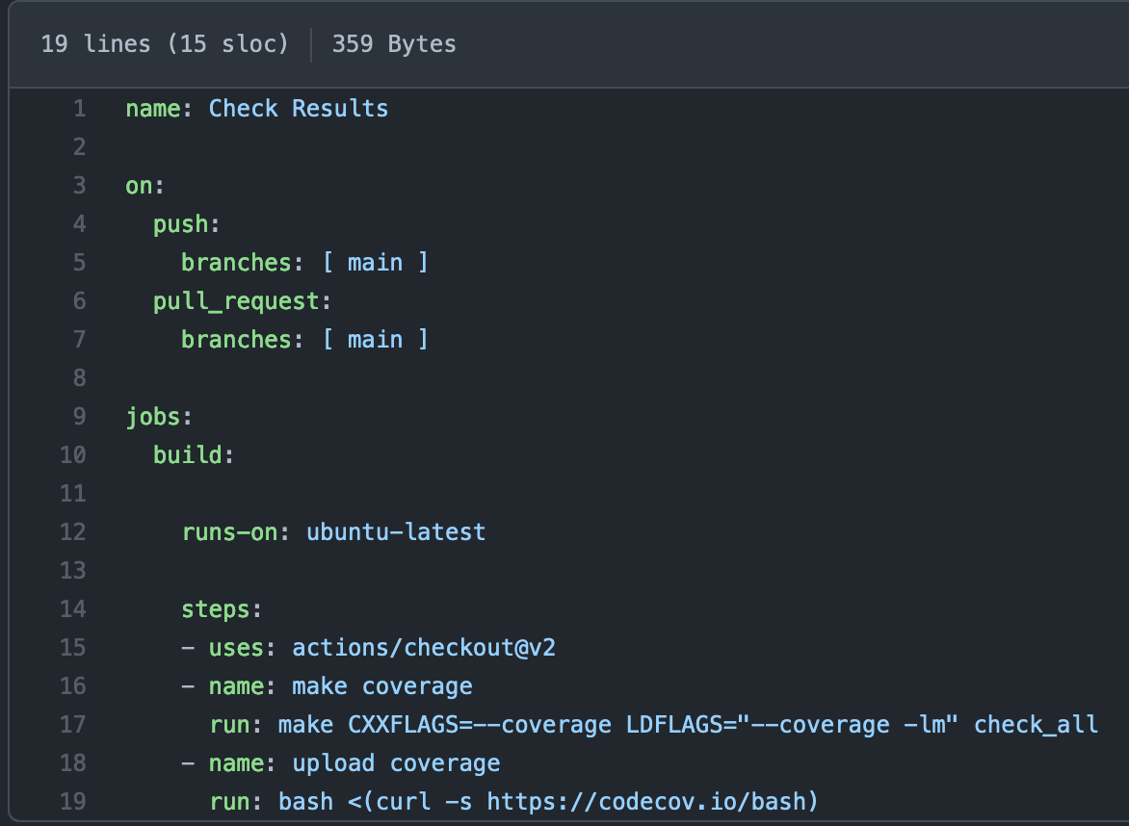
Getting started with Github Actions:
Notes:
Update example to use GitLab? Should we even have this part? Stress getting things generally in order so they are adaptable to ECP CI.

Slide 13
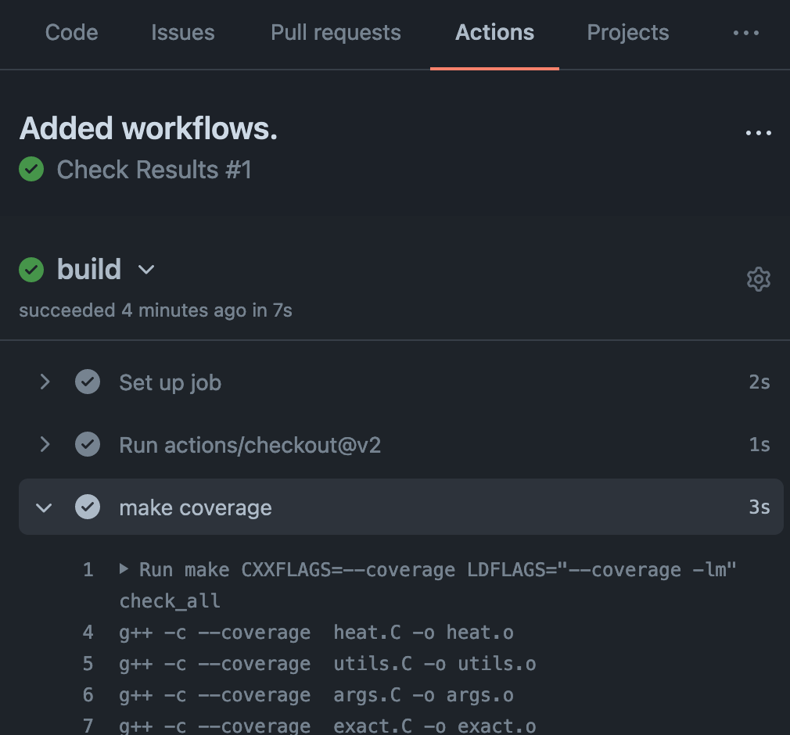
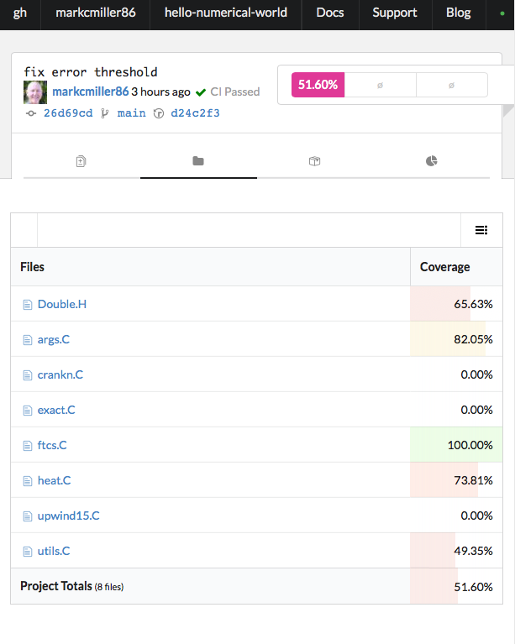
github.com
codecov.io
Notes:
Consider dropping this slide?

Slide 14
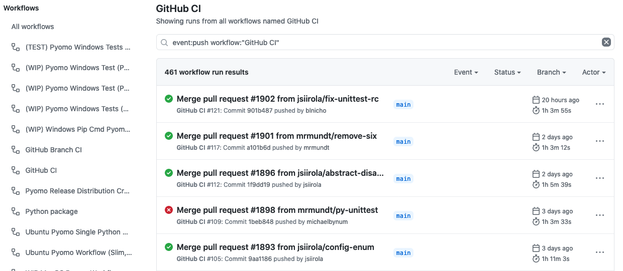
GitHub Actions – results of workflow test runs

Slide 15
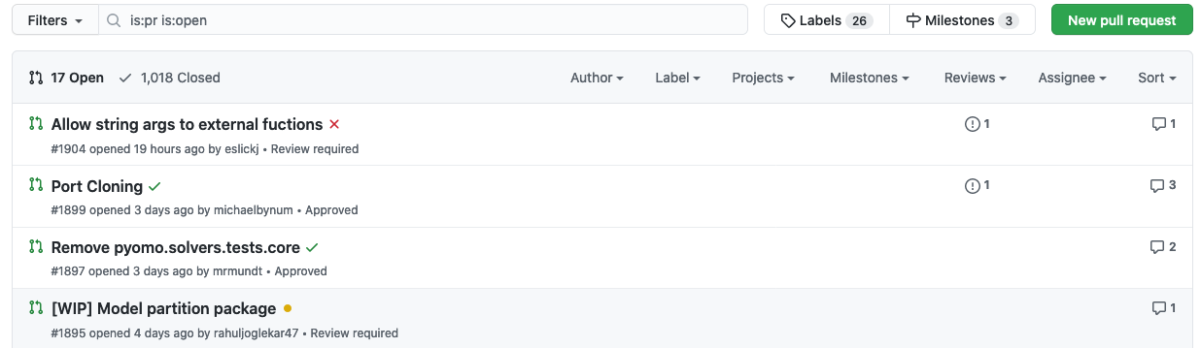
GitHub Pull Request Status Indicators

Slide 16
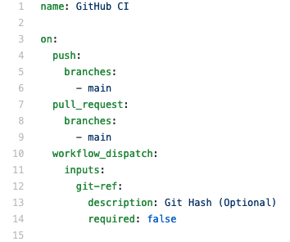
GitHub Actions – Key Elements of Defining Tests
Name
Trigger
Notes:
A more complicated example. However, the Pyomo team started with a fairly basic setup, and grew from there

Slide 17
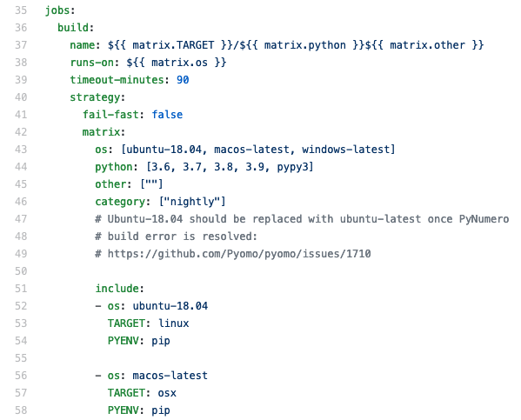
GitHub Actions – Key Elements of Defining Tests
Job setup
Name
Trigger

Slide 18
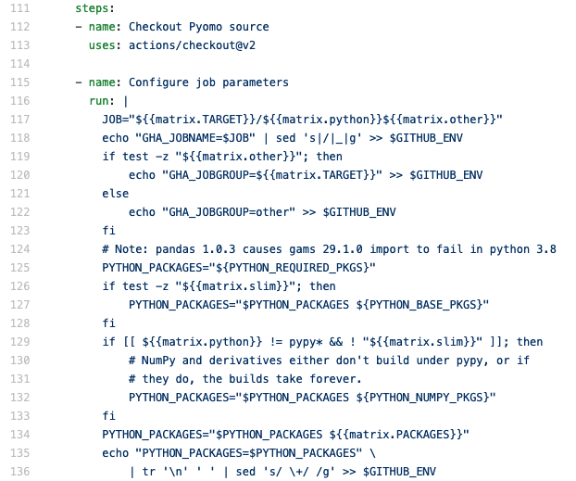
GitHub Actions – Key Elements of Defining Tests
Job steps

Slide 19
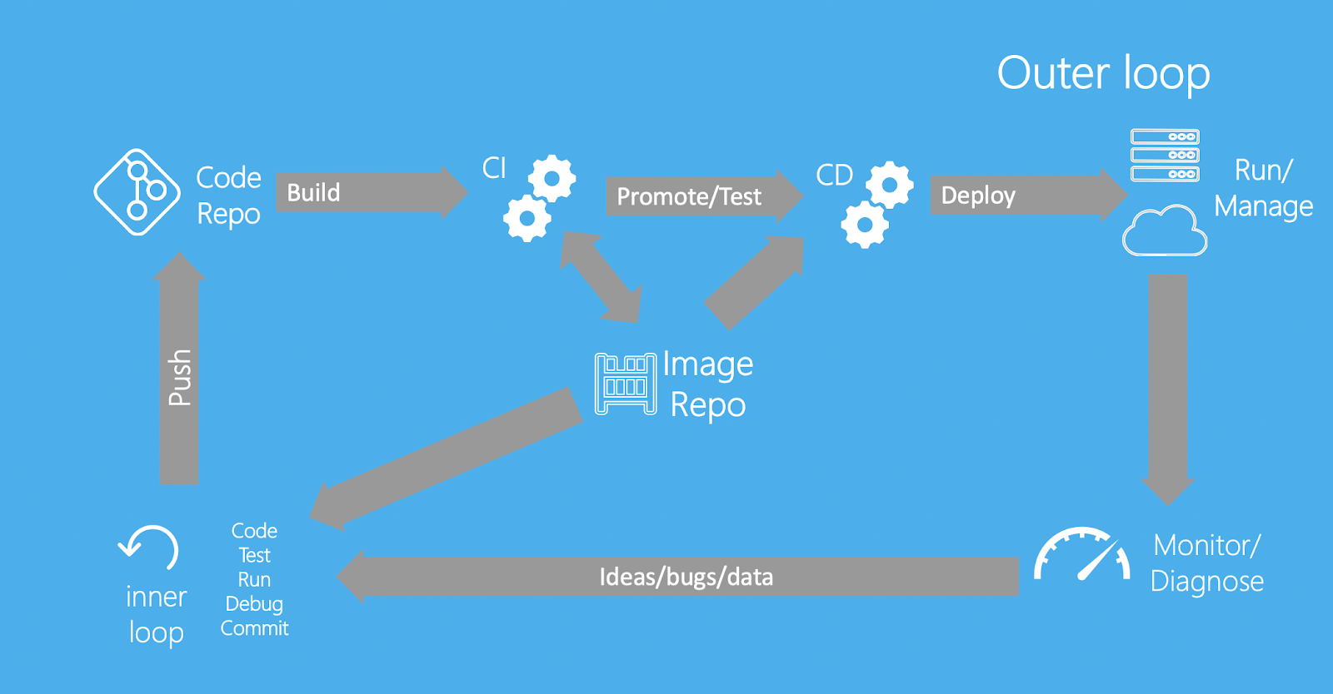
Going Further with CI
Mirror inner and outer test loops
High-level build systems
Makefile
autoconf / cmake
spack (spack.readthedocs.io)
containers? (e.g. in e4s-project)
Enable caching
uses: actions/cache@v2 (github)
cache: (gitlab)
Automate Releases
https://docs.docker.com/ci-cd/best-practices/

Slide 20
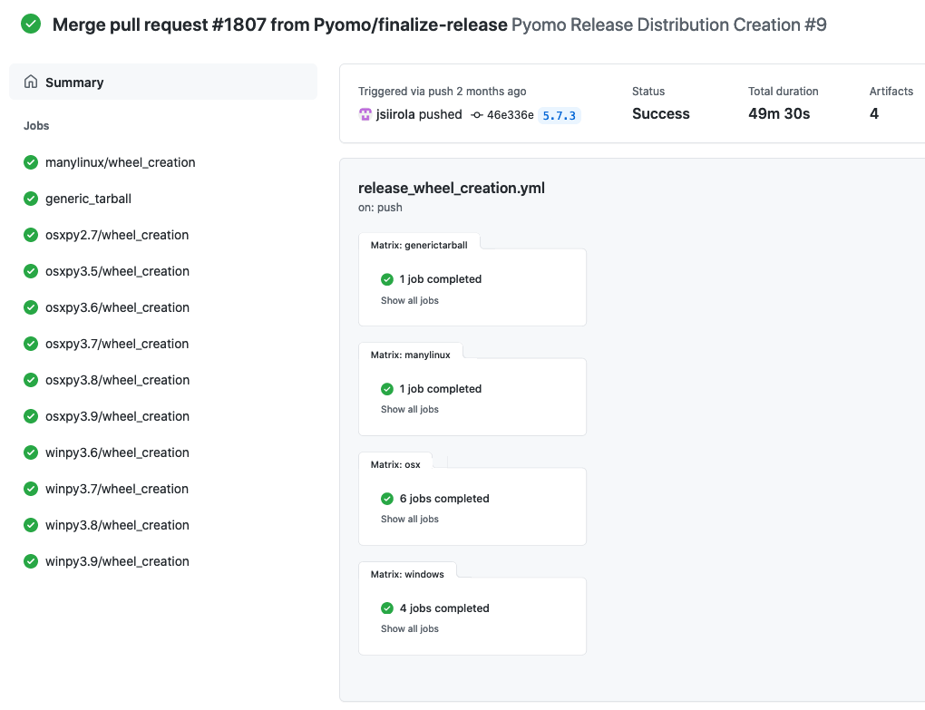
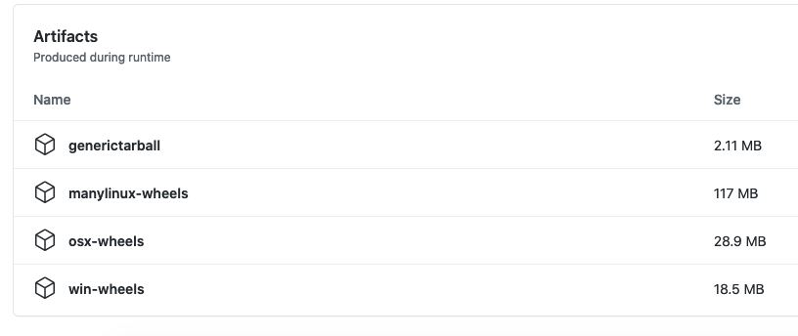
GitHub Actions - Release Automation

Slide 21
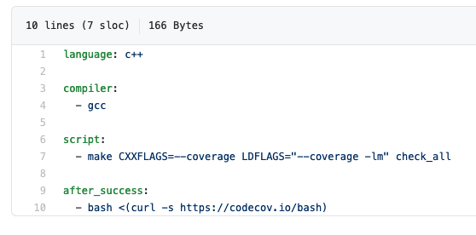
Many Alternatives, e.g. gitlab, circle-ci, and Travis CI:
.travis.yml
Notes:
Update example to use GitLab? Should we even have this part? Stress getting things generally in order so they are adaptable to ECP CI.

Slide 22
Summary
The purpose of Continuous Integration Testing is to identify problems early
Catch things that would “break the build” or adversely impact other developers
Need to provide sufficient confidence, but run quickly – balance varies by project
CI testing should complement (not replace) more extensive automated “nightly” testing
Use scheduled testing for more and more detailed tests, more configurations and platforms, performance testing, etc.
Many options for where to execute CI tests
Free services are a good (easy) place to start
But may not be sufficient in the long run (especially large HPC/scientific codes)
Start simple to get automation working, then build out what you need
Focus initially on key software configurations and aspects of the code
Make sure your testing expands to cover new code

Slide 23
CI Testing is one part of the “Shift Left” movement in DevOps
Advantage

Slide 24
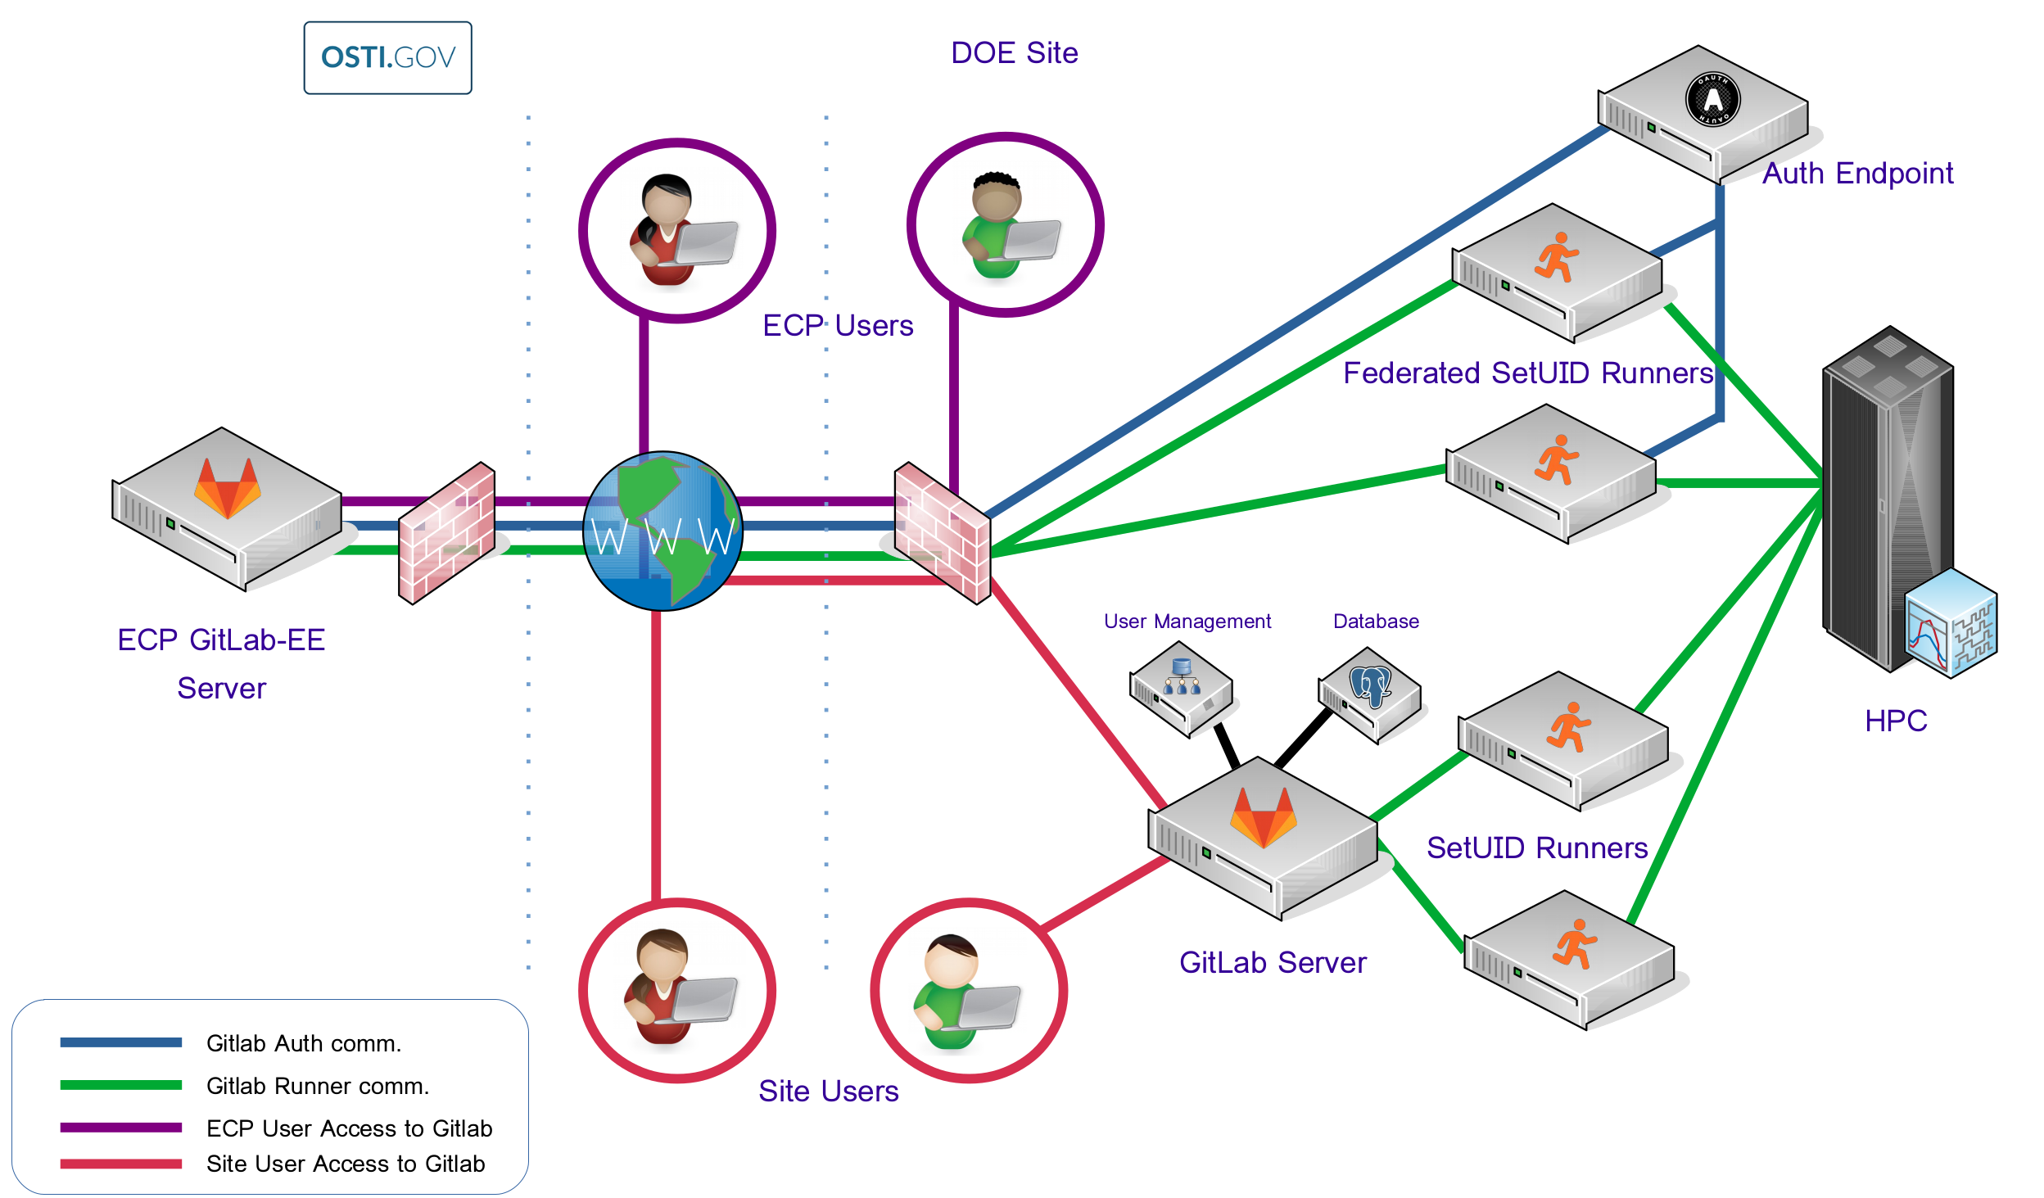
ECP CI Resources
ECP investing in GitLab for complex-wide CI
Complex-wide Federation
Many hurdles still to overcome
More about ECP CI at the Annual Meeting
Benefitting From ECP CI
Wednesday 2:30-3:30 Eastern
ECP CI Startup Tutorial
Friday 2:30-6 Eastern
Documentation and on-boarding help
https://ecp-ci.gitlab.io
Notes:
Here I should reference other presentations at the annual meeting

Slide 25
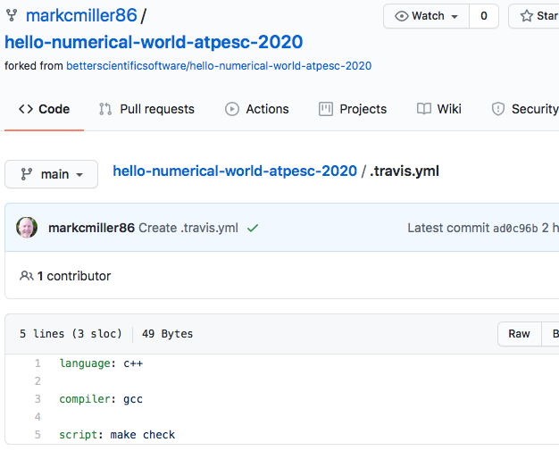
Getting started with CI:
Example .travis.yml file (also doing coverage analysis)
Setting up CI
Service | Interface
Travis | repo YAML file [& repo scripts] | /.travis.yml in root of repo
GitLab | Web page configurator + repo YAML file [& repo scripts] | /.gitlab-ci.yml in root of repo
Bamboo | Web page configurator + repo scripts
GitHub Actions . . | Repo YAML file | .github/workflows/<test_name>.yml
Specify environment
Commands to run test
Keywords defined by service provider’s YAML docs
Notes:
Update example to use GitLab? Should we even have this part? Stress getting things generally in order so they are adaptable to ECP CI.

Slide 26
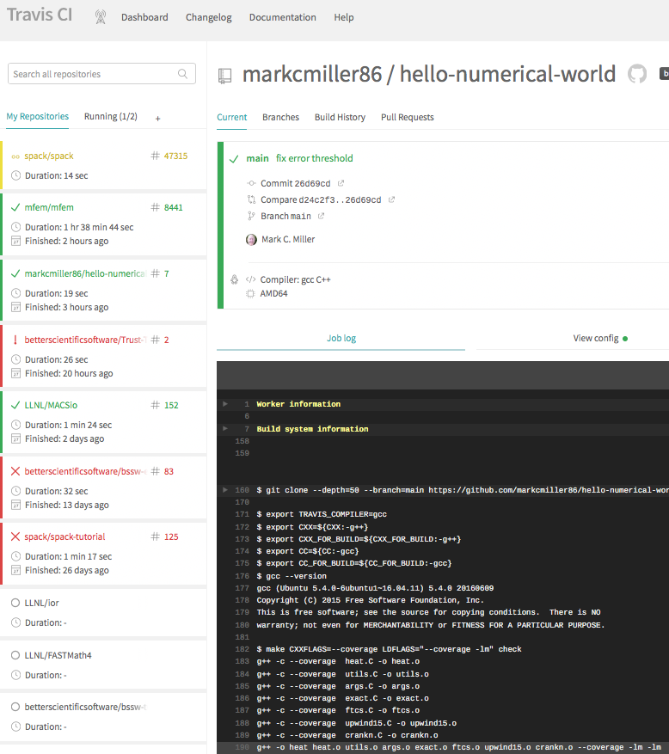
travis-ci.com
codecov.io
Notes:
Consider dropping this slide?

